Slide 1
Backlog NSR,
RESULTS Data Trends and Training Needs
Land Based Investment Strategy (LBIS):
Current Reforestation Planning and Delivery Workshop
September 12, 2012
Richmond, BC
Caroline MacLeod
Matt LeRoy
Resource Practices Branch

Slide 2
Goals and Objectives
Backlog NSR update
Data Requirement and RISS
Data Quality
Training

Slide 5
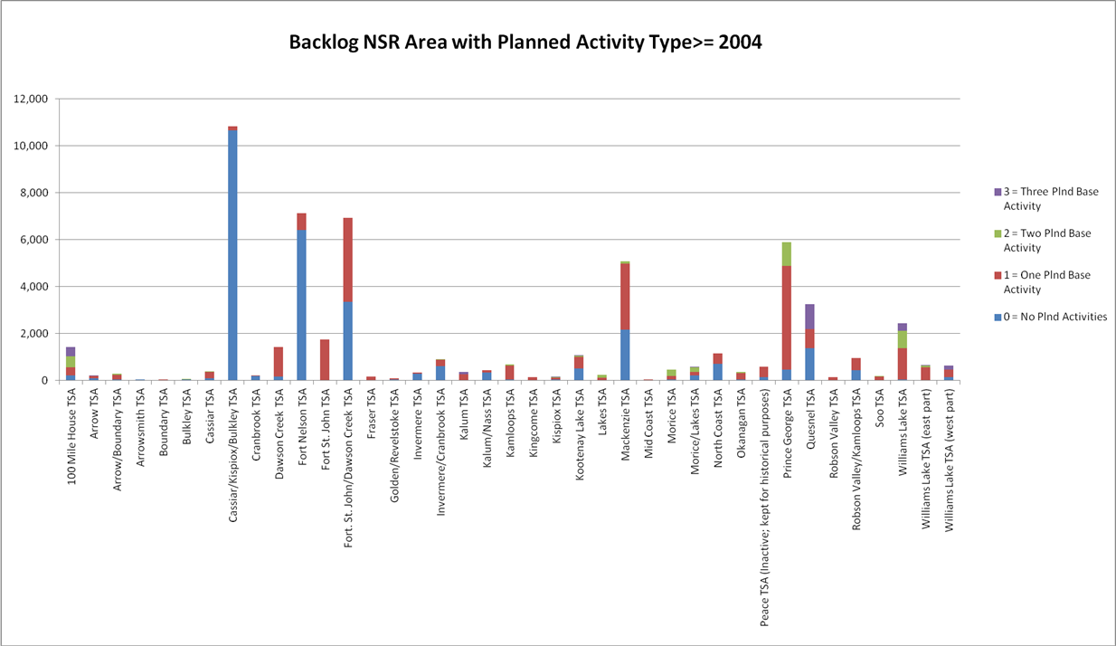

Slide 6
Known Challenges:
  Not just an opening file exercise
  Getting down to the most challenging openings
Comments/Questions:
  Aerial overview flights, for DSS, DFN
  Do folks know about their options with survey standards?
  **Chartwell is on deck to help with data entry, surveys, forest cover submissions etc.
  September 20th backlog NSR meeting

Slide 7
RESULTS – Reporting Review

Slide 8
RESULTS – Reporting Review

Slide 9
RESULTS – Reporting Review

Slide 10
RESULTS – Reporting Review

Slide 11
RESULTS Training Plan
  Potential for increasing training requirement and move to a certification model;
  Existing training material and recorded sessions on RPB hosted Live Meeting site;
  Forward planning session;
  Snap Tool/Survey Wizard Training;
  EzLink Training;
  “One on One” sessions via Live Meeting.

Slide 12
Summary
Backlog NSR updates
Need for better data
Need for more training based on job functions and individual needs
Need for complete planning activities in RESULTS

Slide 13


